Slide 1
Examining thermokarst initiation with random forest models
Rawser Spicer
Committee: Dr. Orion Lawlor, Dr. Bob Bolton, Dr. Glenn Chappell

Slide 2

Committee
Dr. Orion Lawlor
Dr. Bob Bolton
Dr. Glenn Chappell

Slide 3
Outline
Introduction
Background
Data
Methods
Choosing a Baseline Model
Sensitivity Analysis
Conclusions

Slide 4
Introduction
Goal
Develop a random forest model that can accurately simulate the results of an existing model for thermokarst initiation
Reasoning
Existing models may be large or slow, and random forest models can provide a good estimation while being smaller and faster.
Techniques applied here can be applied to other areas Including other portions of the Alaska Thermokarst Model as reduced order models
Notes:
I wanted to create a random forest models to accurately simulate the results of an existing method for predicting thermokarst initiation
Wantned to find out if random forests could could be used for these types of processes
If they worked here, then the teqniques could be applied to other more models

Slide 5
Background
Permafrost & Thermokarst
Importance of Study
Decision Trees
Bootstrapping & Bagging
Random Forests

Slide 6
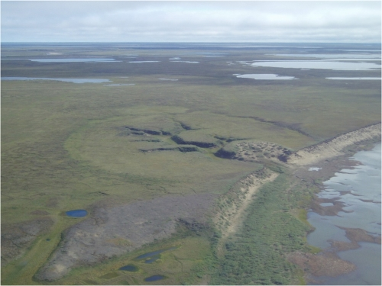
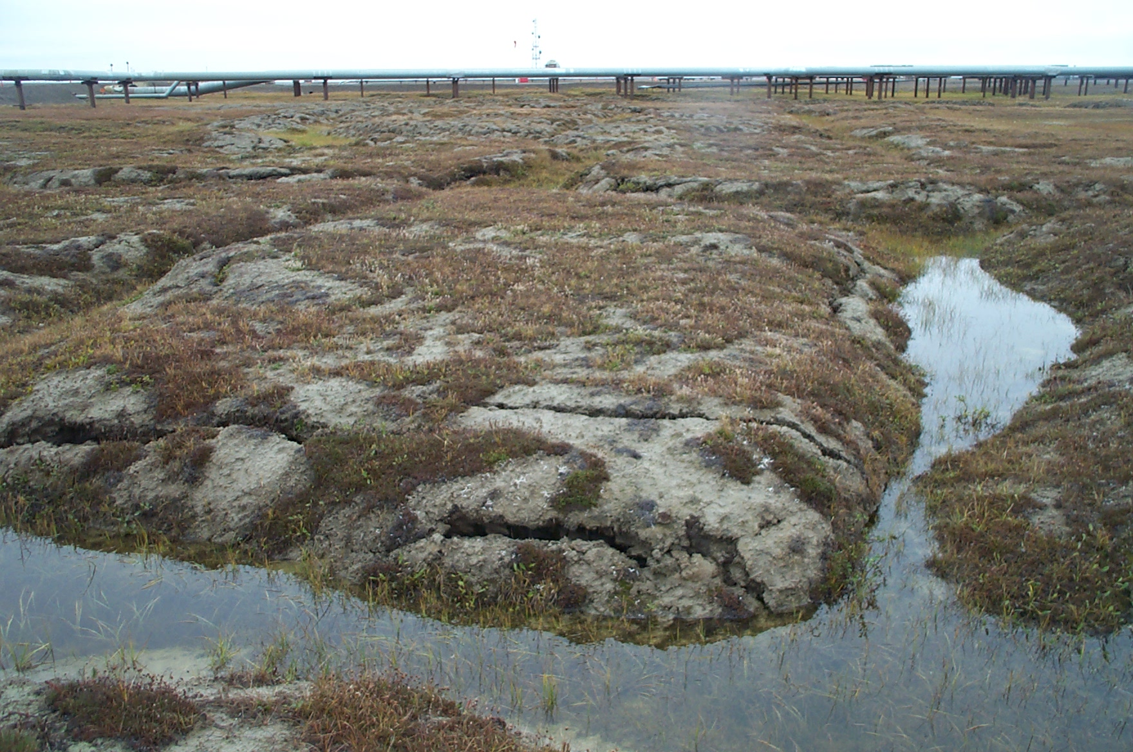
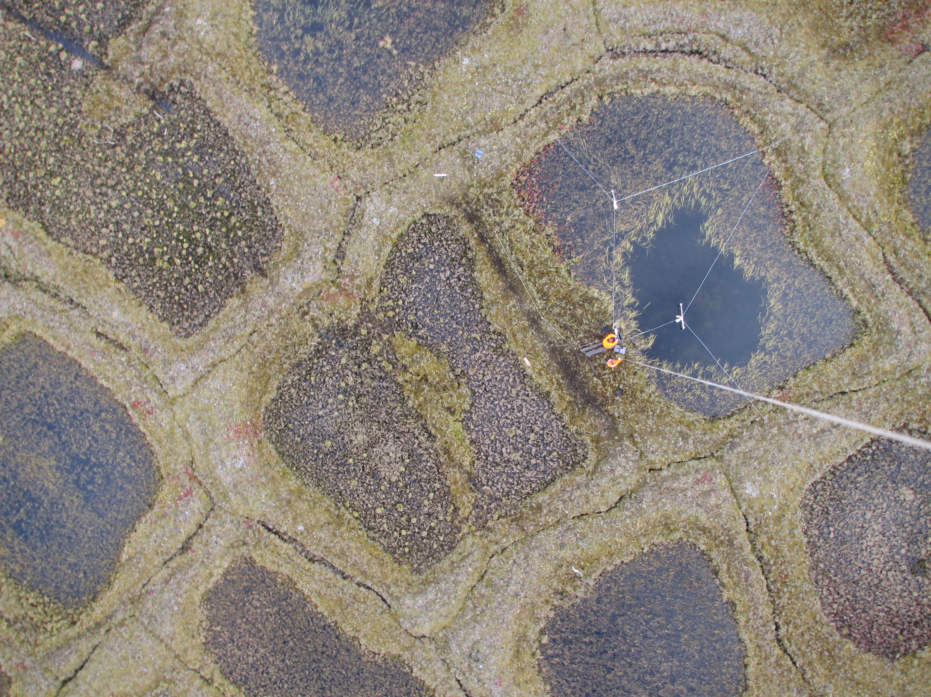
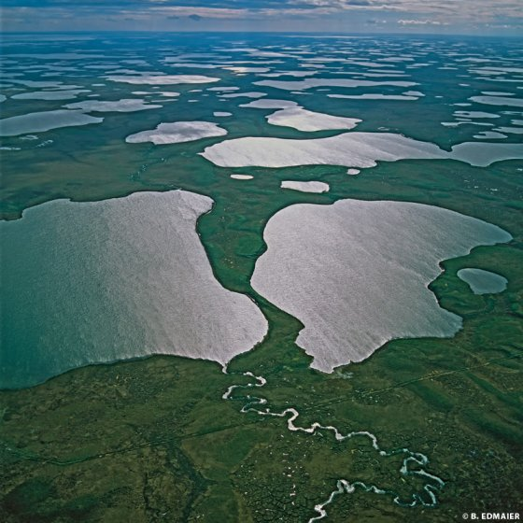
Permafrost & Thermokarst
Non-Polygonal Ground
Low Centered Polygon
Permafrost occurs when soils remain continuously frozen for two or more consecutive years.
Thermokarst features are caused by thawing ground Ice.
Thermokarst features include polygonal patterned ground, and thermokarst lakes
J. Boike
Lakes
B. Jones
High Centered Polygon
L. Hinzman
IPA Website
Notes:
Permafrost soils are soils that are continuously frozen
Durring summers the top layers of the permafrost thaw forming an active layer
Plants grow there.
Called ALD or ALT
Normally refreezes in winter.
Thermokarst
see pics
npg == meadows
LCP == ice wedges pushing up soil, creates ‘tubs’
HCP == Ice wedge collapse creates troughs and ‘islands’
Lakes and ponds, troughs erode ‘islands’ creating larger ponds

Slide 7
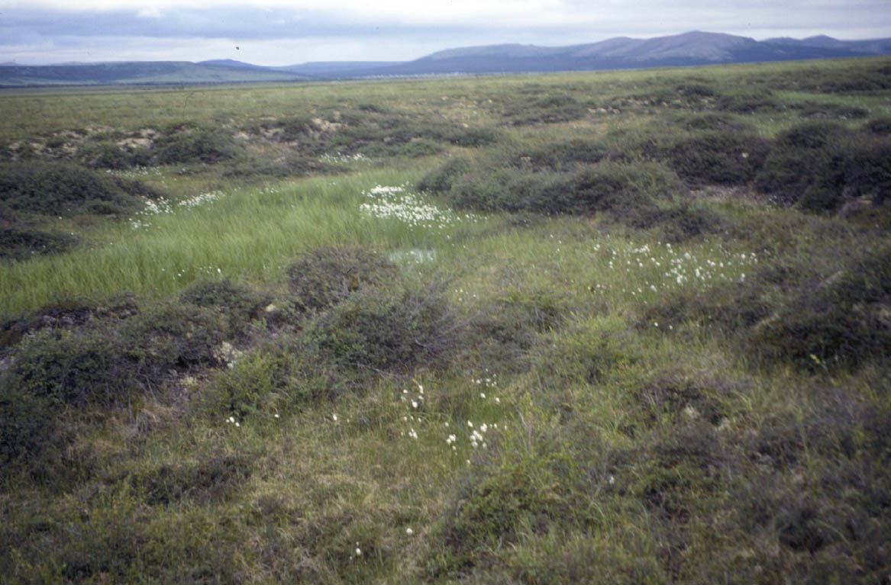
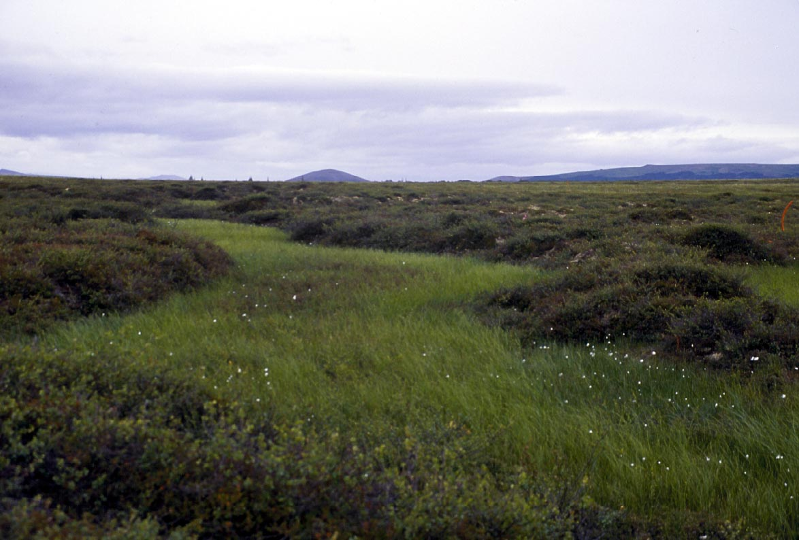

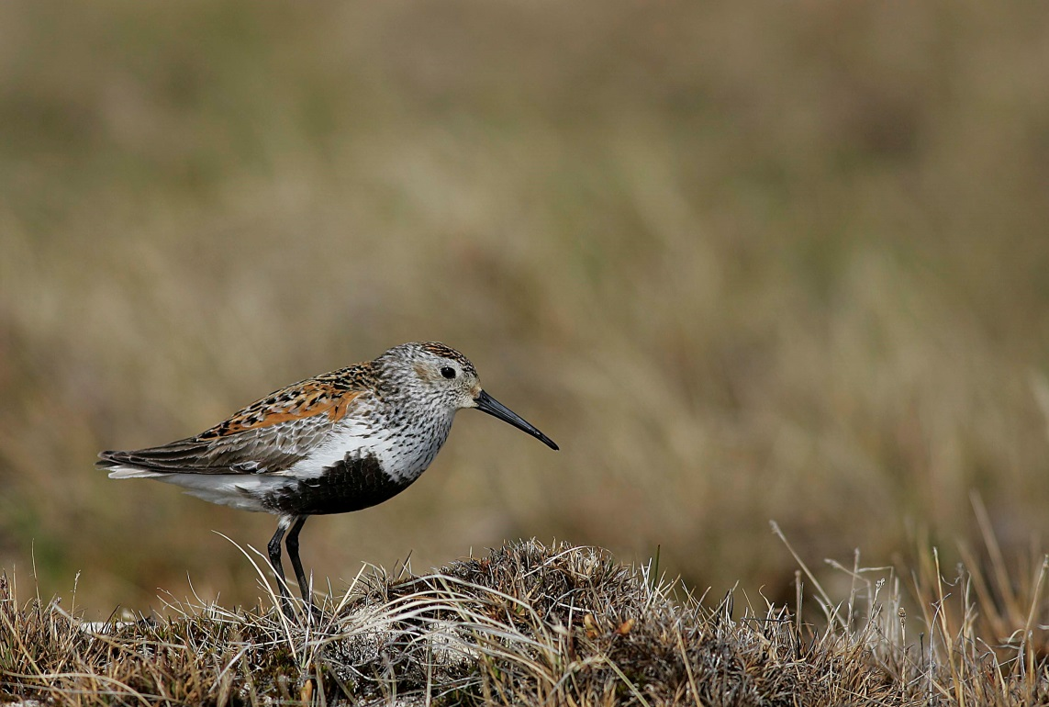
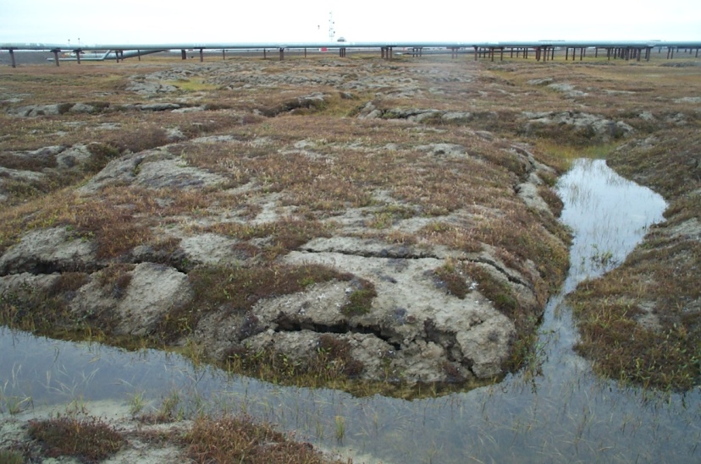
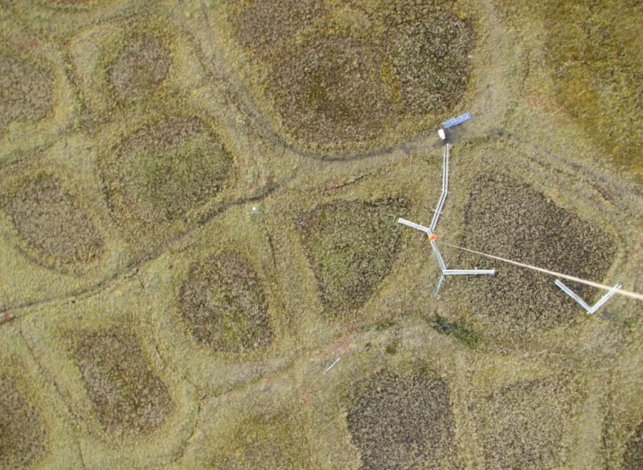
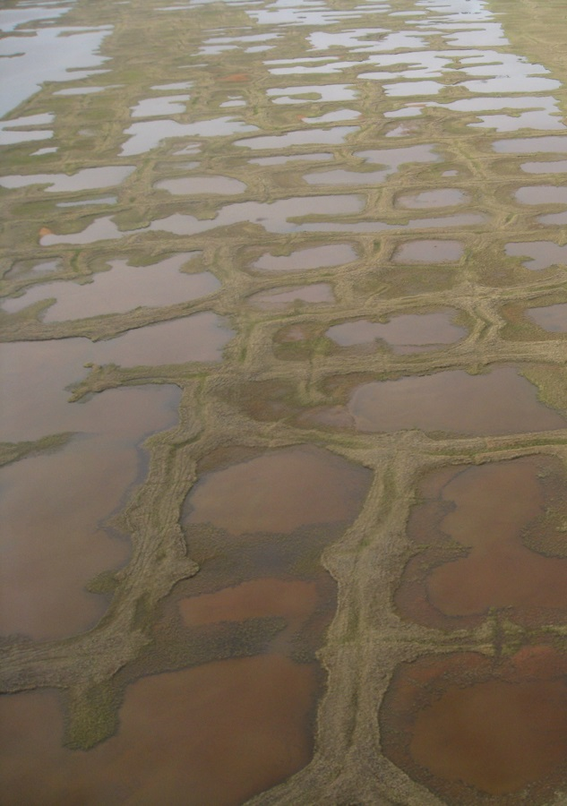
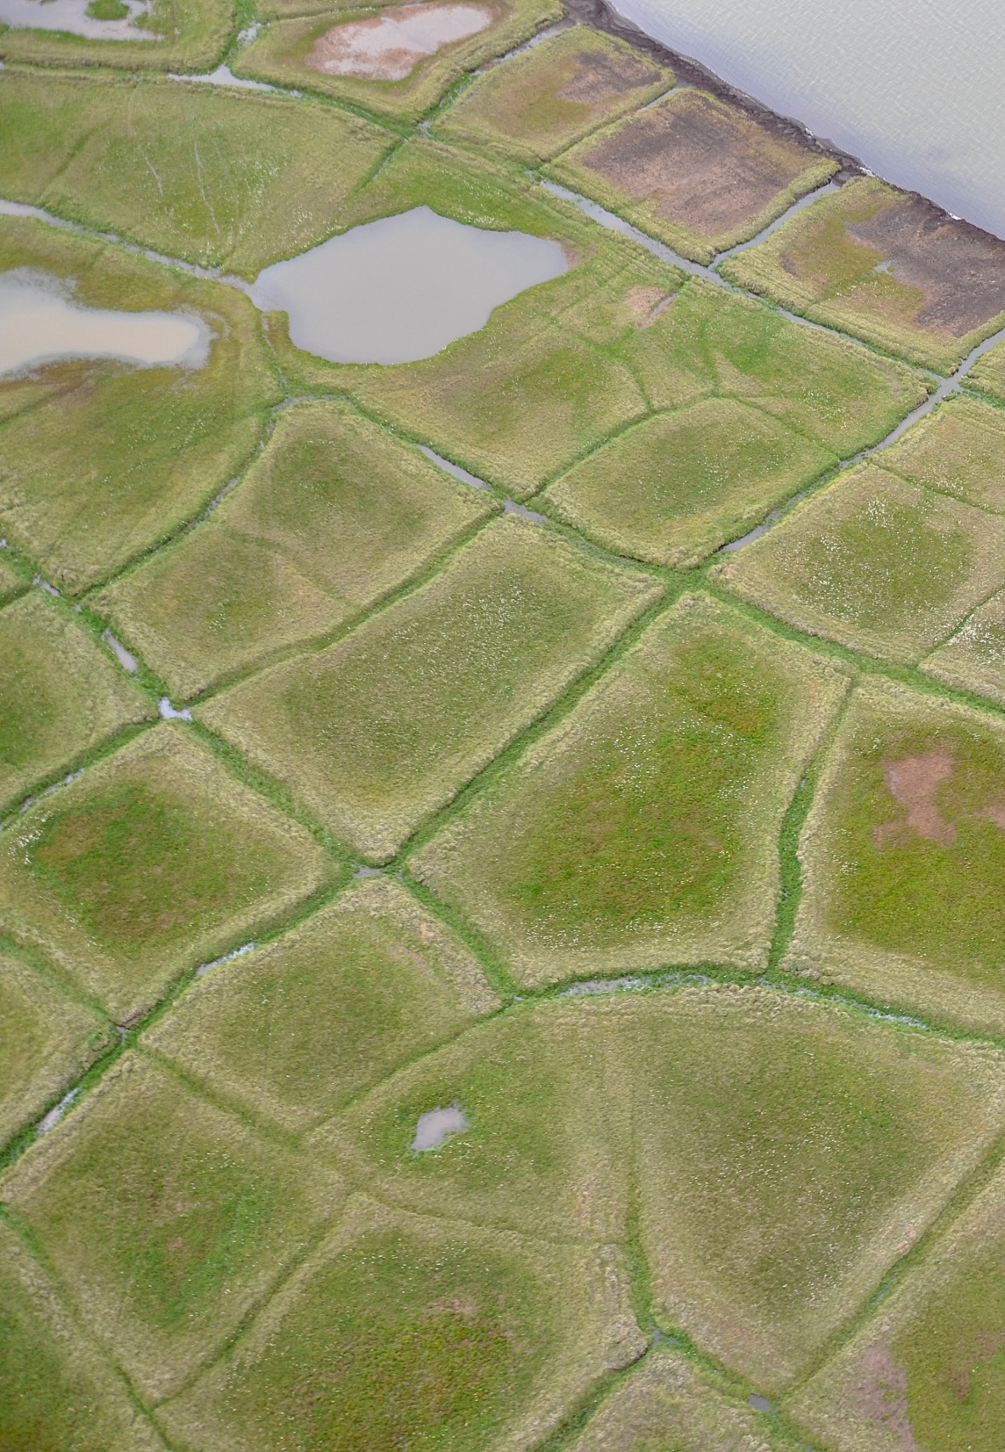
Importance of Study
A: Vegetation
Understanding thermokarst initiation and resulting changes to arctic landscape are important to understanding changes in vegetation, wildlife, drainage patterns, and the carbon & energy regimes. These changes are at the intersection of climate, ecosystem, hydrology and permafrost sciences. Understanding how the landscape evolves in permafrost regions is of interest to wildlife managers and for understanding feedbacks to the climate system.
B: Wildlife
Philip Martin
Philip Martin
C: Drainage
Lawrence Berkeley Nat'l Lab –
Roy Kaltschmidt, photographer
Image courtesy of Julia Boike
D: Energy Regime
Q_{e}
CH₄
Q_{h}
CO₂
Q_{h}
CO₂
Q_{e}
CH₄
Notes:
Changes in vegetation, and wildlife habitat
Changes in drainage
Changes in energy, and carbon fluxes
All have to do with where surface water is
Effect wildlife management, construction and other modeling efforts

Slide 8
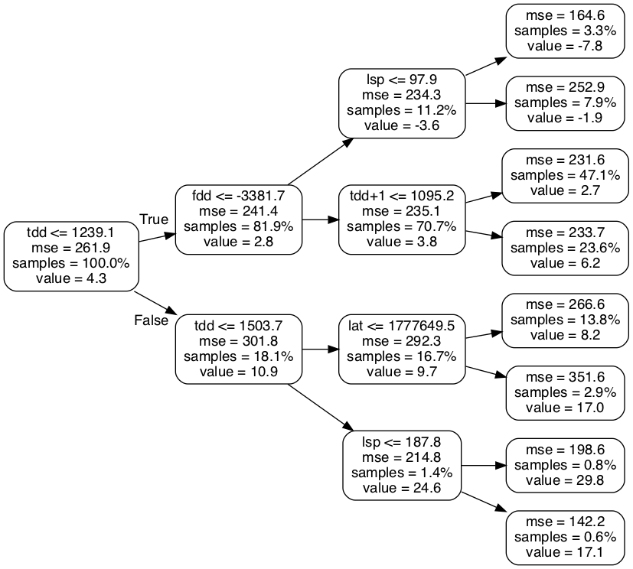
Decision trees
Method of classification and regression
Tree containing decision nodes (questions) and leaf nodes (predictions)
Built by splitting the training set recursively at each decision node into two subsets at each node until only leaf nodes remain
Each split is based on a single most relevant question.
This question is determined using the Gini impurity
Prone to overfitting
Notes:
most relevant question -> produces best splits
Gini impurity
Measure of how often items in the new subsets would be incorrectly labeled

Slide 9
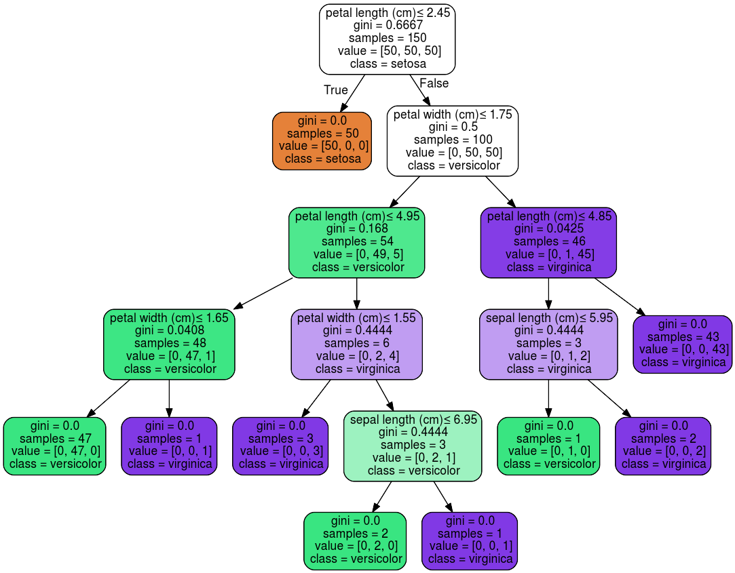
Decision trees
Method of classification and regression
Tree containing decision nodes (questions) and leaf nodes (predictions)
Built by splitting the training set recursively at each decision node into two subsets at each node until only leaf nodes remain
Each split is based on a single most relevant question.
This question is determined using the Gini impurity
Prone to overfitting
Notes:
most relevant question -> produces best splits
Gini impurity
Measure of how often items in the new subsets would be incorrectly labeled

Slide 10
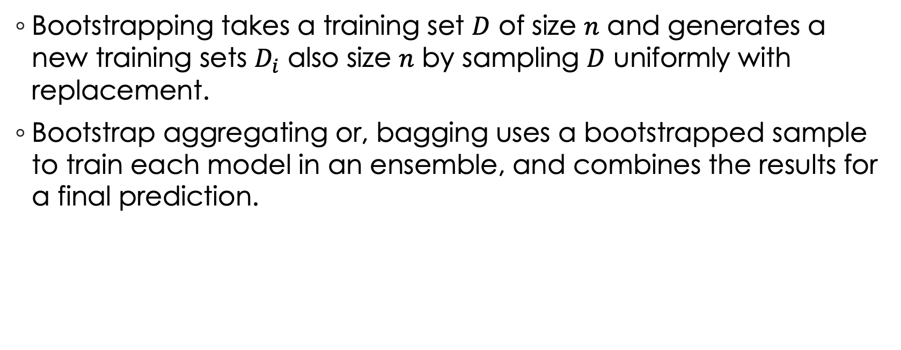
Bootstrapping & Bagging
Bootstrapping takes a training set $D$ of size $n$ and generates a new training sets $D_{i}$ also size $n$ by sampling $D$ uniformly with replacement.
Bootstrap aggregating or, bagging uses a bootstrapped sample to train each model in an ensemble, and combines the results for a final prediction.
Notes:
Bootstraping is a way of creating random subsamples that are the same size as the original data set
done by samping with replacement
When $n$ is large each bootstrapped sample $D_{i}$ has about 63% of unique values from $D$
Bootstrap aggergating of bagginh
using bootstrap samples to train each sub model in ensamble modeling techniques
Polling us used for classification, and averaging is used for regression

Slide 11
Random Forests
Ensemble of decision trees used for classification, or regression
Polls/Averages the result of each decision tree in the forest to determine the outcome
Avoid overfitting that may occur in decision trees
Each tree is trained using bootstrapped sample, and a random subset of questions at each decision node. This creates independent trees.
As the number of trees in the forest increases the results approach the expected value
Notes:
Ensemble of decision trees used for classification, or regression
Each tree ‘Acts as an expert’
Polling many ‘experts’ is better than asking one
As N trees increases the accuracy should approach expected value according to the law of large number

Slide 12
Data
Raster Data
Data used includes temperature, precipitation, latitude, longitude, slope, aspect, and elevation
Two Areas Examined
Arctic Costal Plain, and Seward Peninsula
Data sourced from
SNAP: For climate data
Alaska DGGS: elevation data
Notes:
All data in raster format
Air Temperature
Summer, and winter as TDD, and FDD
Precipitation
Summer, late Summer, early Winter, and total Winter
Location
Latitude and longitude
Elevation
Elevation, slope, and aspect

Slide 13
Data
Air Temperature
Summer, and winter
Precipitation
Summer, late Summer, early Winter, and total Winter
Location
Latitude and longitude
Elevation
Elevation, slope, and aspect

Slide 14
Air Temperature
Air temperature expressed as freezing degree days (FDD) or thawing degree days (TDD)
Calculated from monthly data using a spline function
Thawing degree days is used to measure summer temperatures
Higher numbers indicate warmer summers (values are > 0)
Freezing degree days is used to measure winter temperatures
Higher numbers indicate warmer winters (values are < 0)
High temperatures can indicate increased thawing in permafrost
We will look at summer temperatures for the year N and year N+1
We will look at winter temperatures for the winter between year N and year N+1

Slide 15
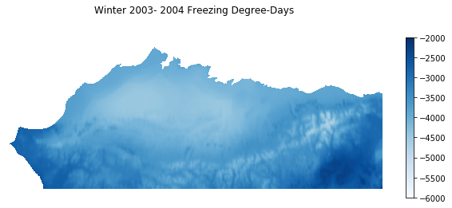

Slide 16
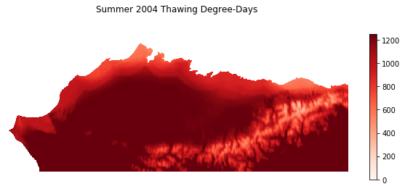

Slide 17
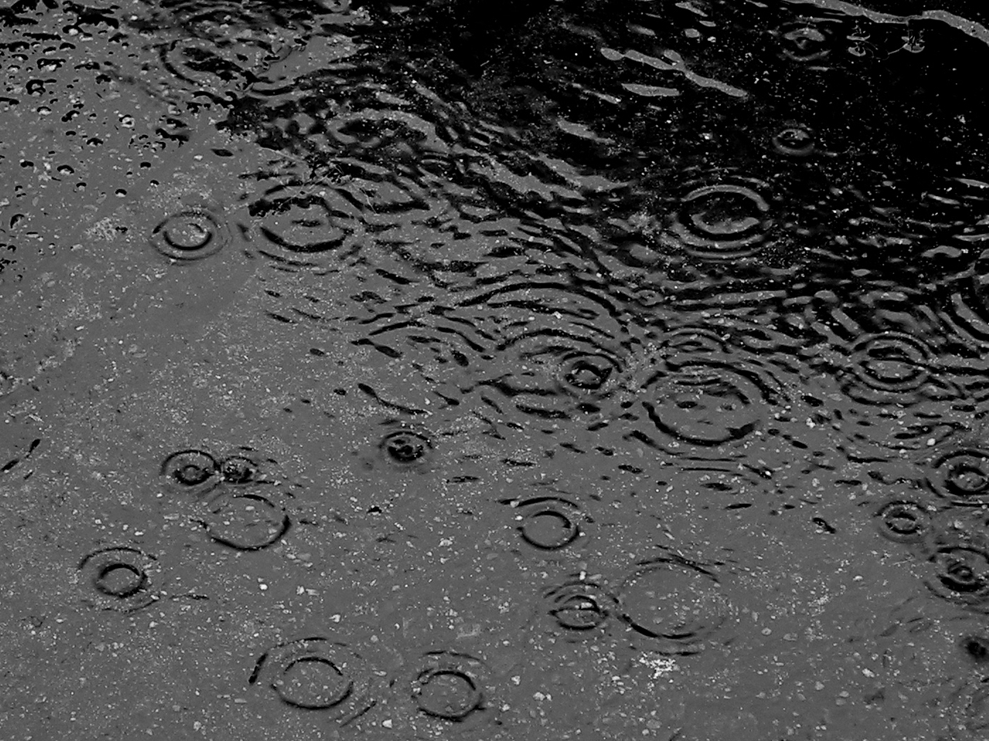
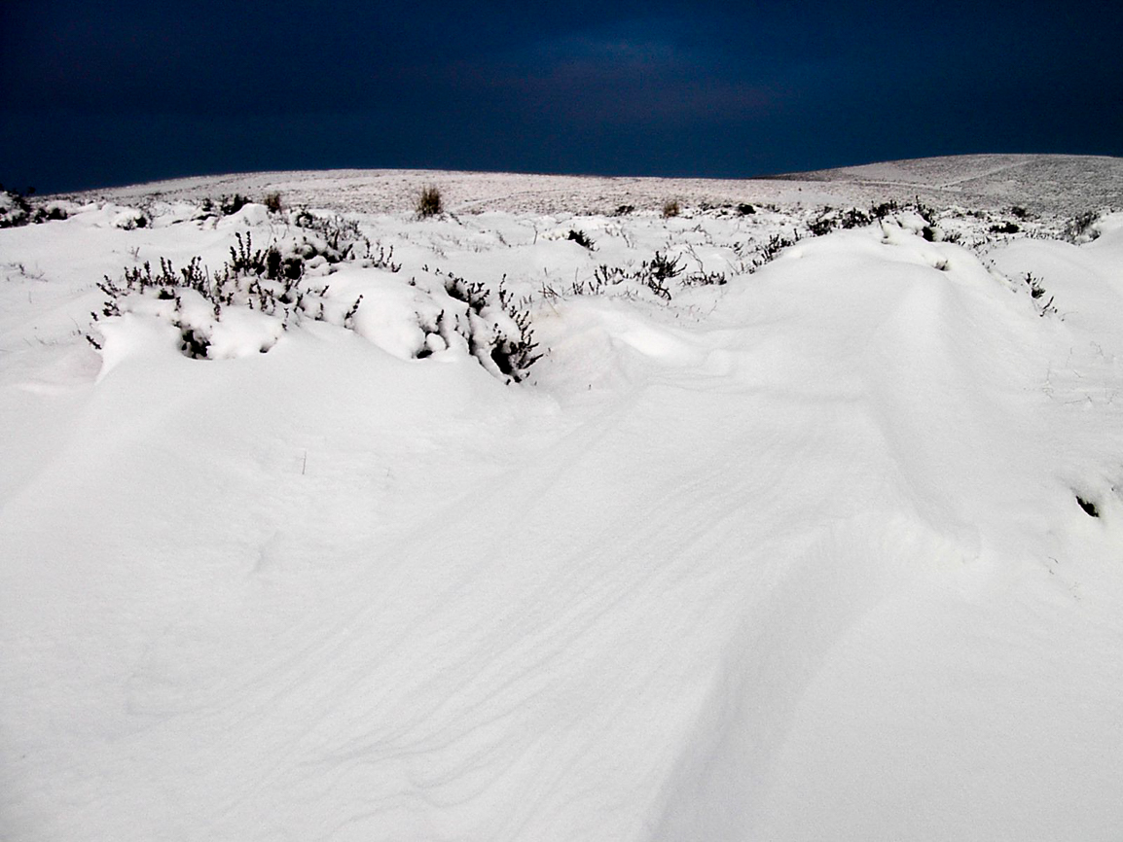
Precipitation
Precipitation is measured in mm
We will look at early winter precipitation for year N, full winter precipitation spanning yean N and N+1 , summer precipitation in year N and N+1, and late summer precipitation in year N.
It is thought that high winter precipitation as snowfall insulates the ground which causes a slowing in the refreezing of the active layer
Summer precipitation can increase thawing of permafrost, and add heat into soil.

Slide 18
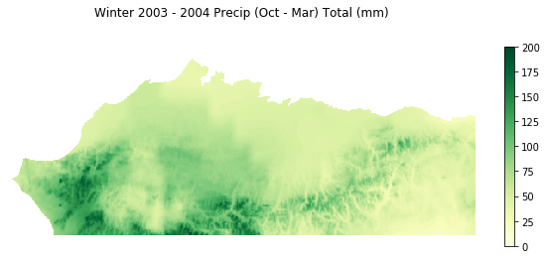

Slide 19
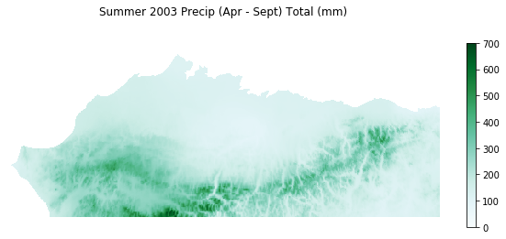

Slide 20
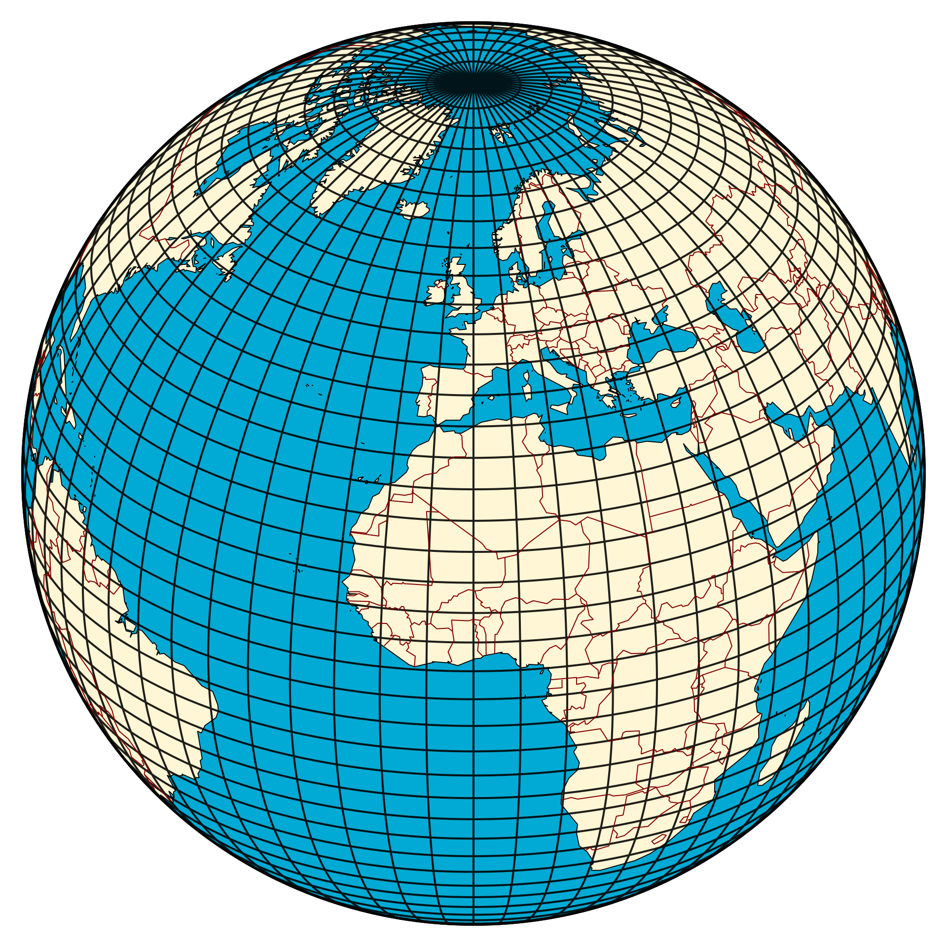
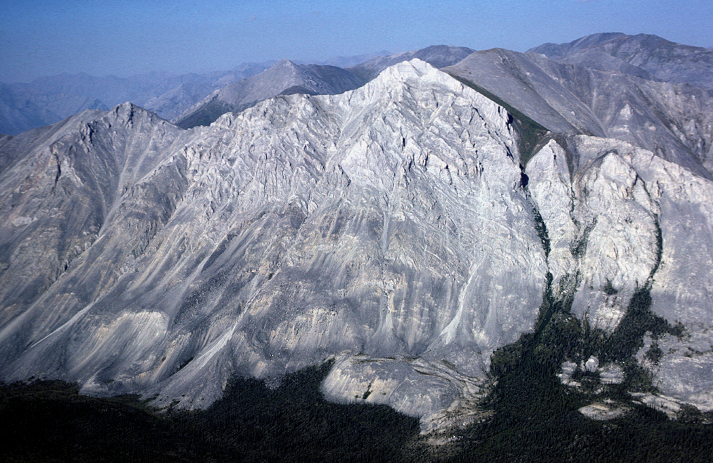
Latitude, Longitude, Elevation, Slope, and Aspect
Latitude, longitude calculated using affine transform in raster metadata
Examine if location effects thermokarst inhiation.
Elevation from national elevation dataset
Slope and aspect calculated from this elevation data
Notes:
Elevation data resampled from 60m to 1000m

Slide 21
Methods
Climate Priming
Comparing Model Accuracy

Slide 22
Methods
Climate Priming
Comparing Model Accuracy

Slide 23
Software used

Slide 24
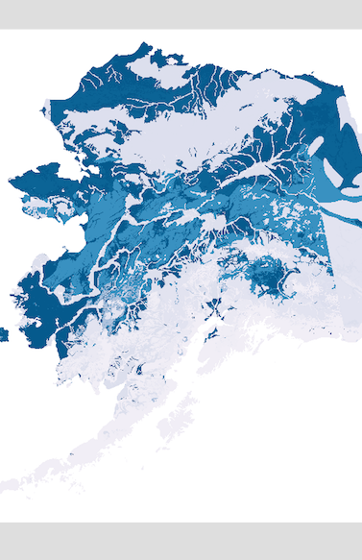
Climate Priming Concept
Look for regions where the temperature and precipitation have been extremely greater than the average for a winter and into the next summer.
Based on field observations on the Seward Peninsula
Can Combine these results with map of thermokarst predisposition
thermokarst predisposition
Notes:
Look for areas where multiple conditions are greater than a historic average
Take the summer temp, eary winter precp, total winter precp, winter temperatures, and next summers temperature.
Ie for 1950 potential initiation, check if 1949 summer temp, ewp, fwp, fdd, and 1950 summer temp are high.
1901-1950 maintain relatively stable climate conditions
Results are also merged with a thermokarst predisposition model, as a post processing step if desired.

Slide 25
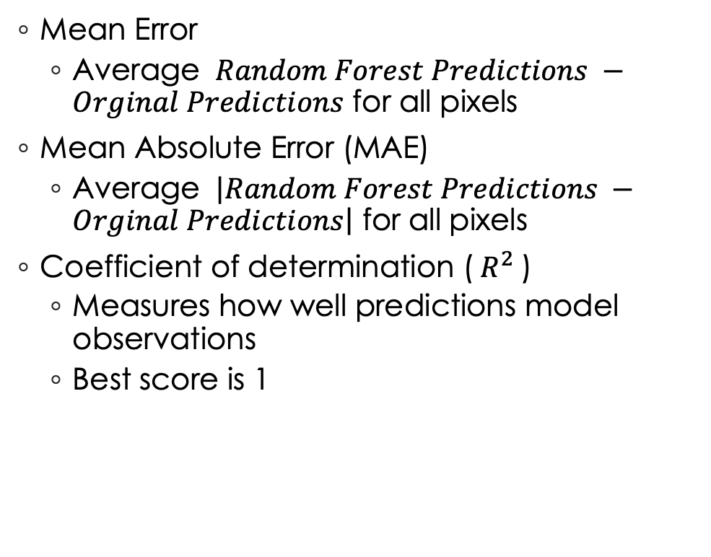
Comparing Model Accuracy
Mean Error
Average $Random Forest Predictions −Orginal Predictions$ for all pixels
Mean Absolute Error (MAE)
Average $\left|Random Forest Predictions −Orginal Predictions\right|$ for all pixels
Coefficient of determination ($R^{2}$)
Measures how well predictions model observations
Best score is 1
Notes:
Also looked at the Variance of the error and absolute error
In this case observations are the predictions from the original model
Merror
Didn’t give good overall indication of how model performed, as values are always close to 0
Use full to tell if model is over predicting or under predicting
MAE
Gives good overall indication of how model performed by showing how far random forest values differ from original
Closer to zero better

Slide 26
Choosing a Baseline Model

Slide 27
Where To Start
Hyperparameters examined
Number of trees/estimators (e)
Number of features considered at each decision node (mf)
Maximum depth for each tree (md)
Maximum number of leaf nodes (mln)
Minimum samples needed to split a decision node (mss)
Minimum samples required to be a leaf node (msl)
Percent of data used for training (tdp)

Slide 28
Where To Start
Random Forest Models have many possible hyperparameters that effect the growth of each tree, but which combination of these produces good results in a reasonable amount of time?
Number of trees/estimators
Number of features considered at each decision node
Maximum depth for each tree
…
Train many models with different combinations of examined hyperparameters, and see what performed best, and were trained in least amount of time.
Notes:
What are the best hyperparameters to train a random forest model.
Performance is easy to measure with $R^{2}$score, and Mean Absolute Error (MAE).
Timing was harder because multiple systems were used.
In the end only looked at performance to pick candidate baseline models.
Despite this all chosen models trained in less than 2 hours regardless of system

Slide 29
Explanation of model naming
Each model is named according to the hyperparameters used to train it
rfm_e[N]_md[M]_mf[O]_..._tdp[z]
rfm_e50_md100_mfAUTO_mln50000_msl8_mss5_tdp75

Slide 30
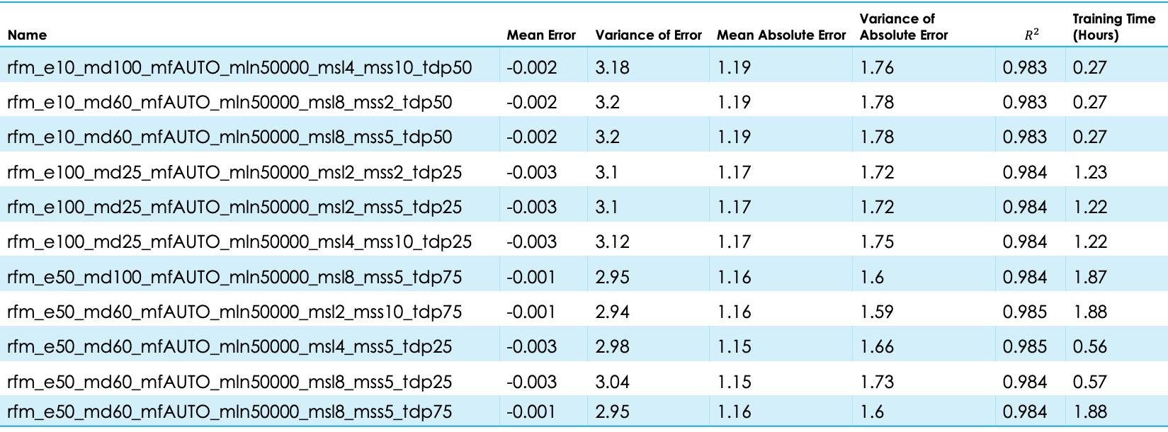
Baseline model options
Name | Mean Error | Variance of Error | Mean Absolute Error | Variance of Absolute Error | $$R^{2}$$ | Training Time (Hours)
rfm_e10_md100_mfAUTO_mln50000_msl4_mss10_tdp50 | -0.002 | 3.18 | 1.19 | 1.76 | 0.983 | 0.27
rfm_e10_md60_mfAUTO_mln50000_msl8_mss2_tdp50 | -0.002 | 3.2 | 1.19 | 1.78 | 0.983 | 0.27
rfm_e10_md60_mfAUTO_mln50000_msl8_mss5_tdp50 | -0.002 | 3.2 | 1.19 | 1.78 | 0.983 | 0.27
rfm_e100_md25_mfAUTO_mln50000_msl2_mss2_tdp25 | -0.003 | 3.1 | 1.17 | 1.72 | 0.984 | 1.23
rfm_e100_md25_mfAUTO_mln50000_msl2_mss5_tdp25 | -0.003 | 3.1 | 1.17 | 1.72 | 0.984 | 1.22
rfm_e100_md25_mfAUTO_mln50000_msl4_mss10_tdp25 | -0.003 | 3.12 | 1.17 | 1.75 | 0.984 | 1.22
rfm_e50_md100_mfAUTO_mln50000_msl8_mss5_tdp75 | -0.001 | 2.95 | 1.16 | 1.6 | 0.984 | 1.87
rfm_e50_md60_mfAUTO_mln50000_msl2_mss10_tdp75 | -0.001 | 2.94 | 1.16 | 1.59 | 0.985 | 1.88
rfm_e50_md60_mfAUTO_mln50000_msl4_mss5_tdp25 | -0.003 | 2.98 | 1.15 | 1.66 | 0.985 | 0.56
rfm_e50_md60_mfAUTO_mln50000_msl8_mss5_tdp25 | -0.003 | 3.04 | 1.15 | 1.73 | 0.984 | 0.57
rfm_e50_md60_mfAUTO_mln50000_msl8_mss5_tdp75 | -0.001 | 2.95 | 1.16 | 1.6 | 0.984 | 1.88

Slide 31
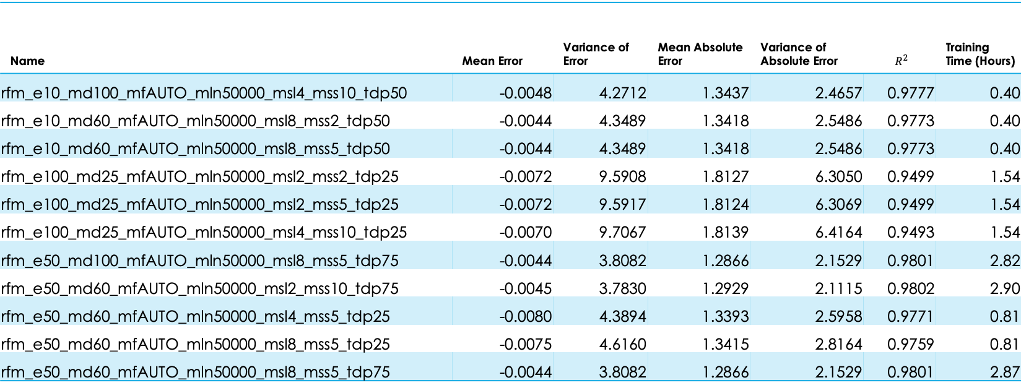
Revised Baseline model options
Name | Mean Error | Variance of Error | Mean Absolute Error | Variance of Absolute Error | $$R^{2}$$ | Training Time (Hours)
rfm_e10_md100_mfAUTO_mln50000_msl4_mss10_tdp50 | -0.0048 | 4.2712 | 1.3437 | 2.4657 | 0.9777 | 0.40
rfm_e10_md60_mfAUTO_mln50000_msl8_mss2_tdp50 | -0.0044 | 4.3489 | 1.3418 | 2.5486 | 0.9773 | 0.40
rfm_e10_md60_mfAUTO_mln50000_msl8_mss5_tdp50 | -0.0044 | 4.3489 | 1.3418 | 2.5486 | 0.9773 | 0.40
rfm_e100_md25_mfAUTO_mln50000_msl2_mss2_tdp25 | -0.0072 | 9.5908 | 1.8127 | 6.3050 | 0.9499 | 1.54
rfm_e100_md25_mfAUTO_mln50000_msl2_mss5_tdp25 | -0.0072 | 9.5917 | 1.8124 | 6.3069 | 0.9499 | 1.54
rfm_e100_md25_mfAUTO_mln50000_msl4_mss10_tdp25 | -0.0070 | 9.7067 | 1.8139 | 6.4164 | 0.9493 | 1.54
rfm_e50_md100_mfAUTO_mln50000_msl8_mss5_tdp75 | -0.0044 | 3.8082 | 1.2866 | 2.1529 | 0.9801 | 2.82
rfm_e50_md60_mfAUTO_mln50000_msl2_mss10_tdp75 | -0.0045 | 3.7830 | 1.2929 | 2.1115 | 0.9802 | 2.90
rfm_e50_md60_mfAUTO_mln50000_msl4_mss5_tdp25 | -0.0080 | 4.3894 | 1.3393 | 2.5958 | 0.9771 | 0.81
rfm_e50_md60_mfAUTO_mln50000_msl8_mss5_tdp25 | -0.0075 | 4.6160 | 1.3415 | 2.8164 | 0.9759 | 0.81
rfm_e50_md60_mfAUTO_mln50000_msl8_mss5_tdp75 | -0.0044 | 3.8082 | 1.2866 | 2.1529 | 0.9801 | 2.87

Slide 32
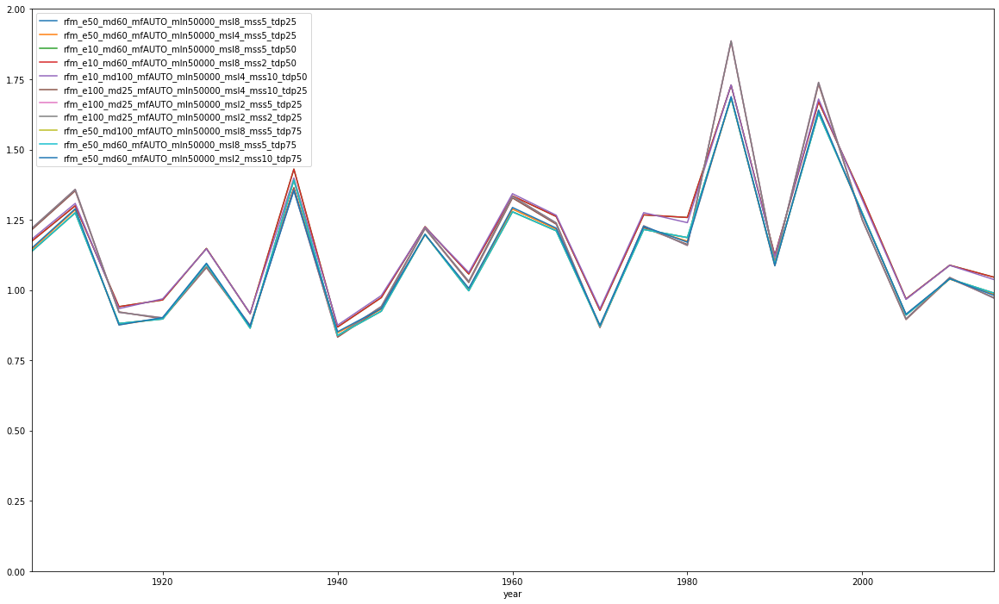
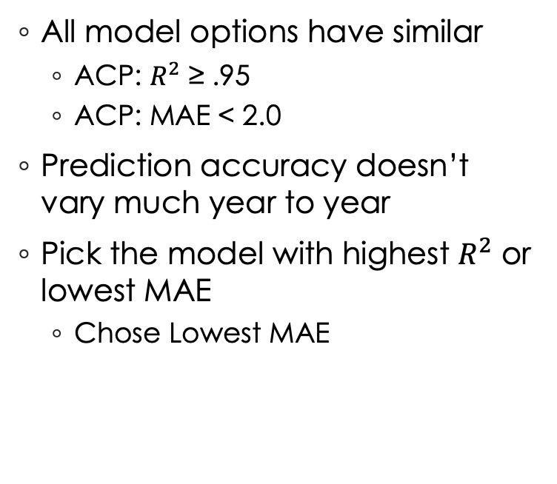
Which model to use as a baseline.
12 Most Accurate Models MAE Over Time
2.0
Mean Absolute Error
All model options have similar
ACP: $R^{2}$ ≥ .95
ACP: MAE < 2.0
Prediction accuracy doesn’t vary much year to year
Pick the model with highest $R^{2}$ or lowest MAE
Chose Lowest MAE
1.5
1.0
0.5
0.0
1940
1980
2000
YEAR
1920
1960
Notes:
Trained on the ACP data set
Did many permutations over ~ 1 month
Choose 12 ‘best’ models as base line candiates
They had similar accuracy
R2 close to 1
MAE < 2
Predictions were close from year to year.
I chose the model with lowest MAE to uses as the baseline for the Sensitivity Analysis

Slide 33
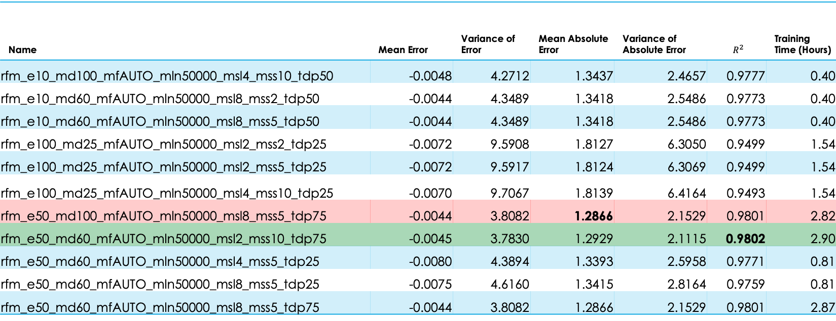
Best options
Name | Mean Error | Variance of Error | Mean Absolute Error | Variance of Absolute Error | $$R^{2}$$ | Training Time (Hours)
rfm_e10_md100_mfAUTO_mln50000_msl4_mss10_tdp50 | -0.0048 | 4.2712 | 1.3437 | 2.4657 | 0.9777 | 0.40
rfm_e10_md60_mfAUTO_mln50000_msl8_mss2_tdp50 | -0.0044 | 4.3489 | 1.3418 | 2.5486 | 0.9773 | 0.40
rfm_e10_md60_mfAUTO_mln50000_msl8_mss5_tdp50 | -0.0044 | 4.3489 | 1.3418 | 2.5486 | 0.9773 | 0.40
rfm_e100_md25_mfAUTO_mln50000_msl2_mss2_tdp25 | -0.0072 | 9.5908 | 1.8127 | 6.3050 | 0.9499 | 1.54
rfm_e100_md25_mfAUTO_mln50000_msl2_mss5_tdp25 | -0.0072 | 9.5917 | 1.8124 | 6.3069 | 0.9499 | 1.54
rfm_e100_md25_mfAUTO_mln50000_msl4_mss10_tdp25 | -0.0070 | 9.7067 | 1.8139 | 6.4164 | 0.9493 | 1.54
rfm_e50_md100_mfAUTO_mln50000_msl8_mss5_tdp75 | -0.0044 | 3.8082 | 1.2866 | 2.1529 | 0.9801 | 2.82
rfm_e50_md60_mfAUTO_mln50000_msl2_mss10_tdp75 | -0.0045 | 3.7830 | 1.2929 | 2.1115 | 0.9802 | 2.90
rfm_e50_md60_mfAUTO_mln50000_msl4_mss5_tdp25 | -0.0080 | 4.3894 | 1.3393 | 2.5958 | 0.9771 | 0.81
rfm_e50_md60_mfAUTO_mln50000_msl8_mss5_tdp25 | -0.0075 | 4.6160 | 1.3415 | 2.8164 | 0.9759 | 0.81
rfm_e50_md60_mfAUTO_mln50000_msl8_mss5_tdp75 | -0.0044 | 3.8082 | 1.2866 | 2.1529 | 0.9801 | 2.87
Notes:
Red lowest MAE <PICKED
Green Lowest R^2

Slide 34
Final Baseline Random Forest Model
50 estimators
Maximum tree depth of 100
All Features considered for decisions
50,000 maximum leaf node
Minimum samples needed to split a node is 8
Minimum sample to be a leaf is 5
75 % of available data used as training data
Notes:
rfm_e50_md100_mfAUTO_mln50000_msl8_mss5_tdp75
Went with lowest MAE
Used for all further sensitivity analysis.
Note this essentially overrides the max depth of 100 as $50,000<2^{100}$

Slide 35
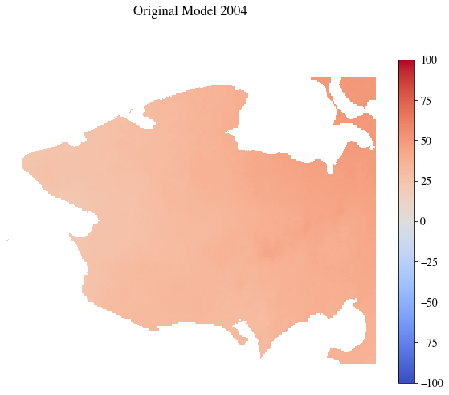
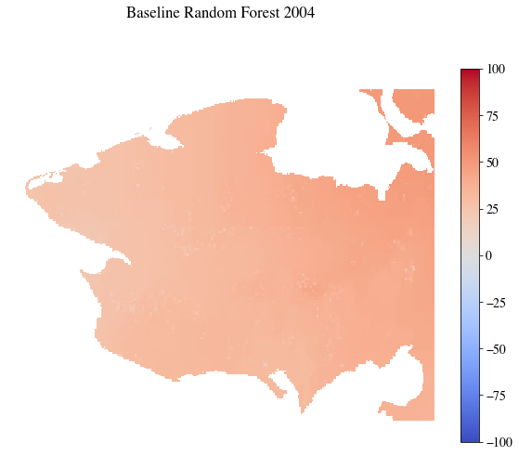
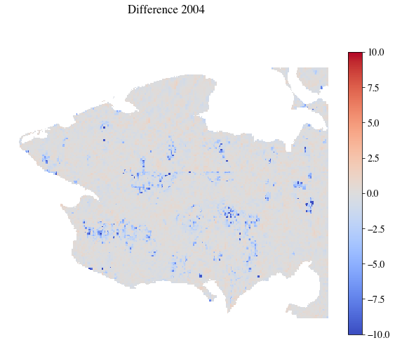
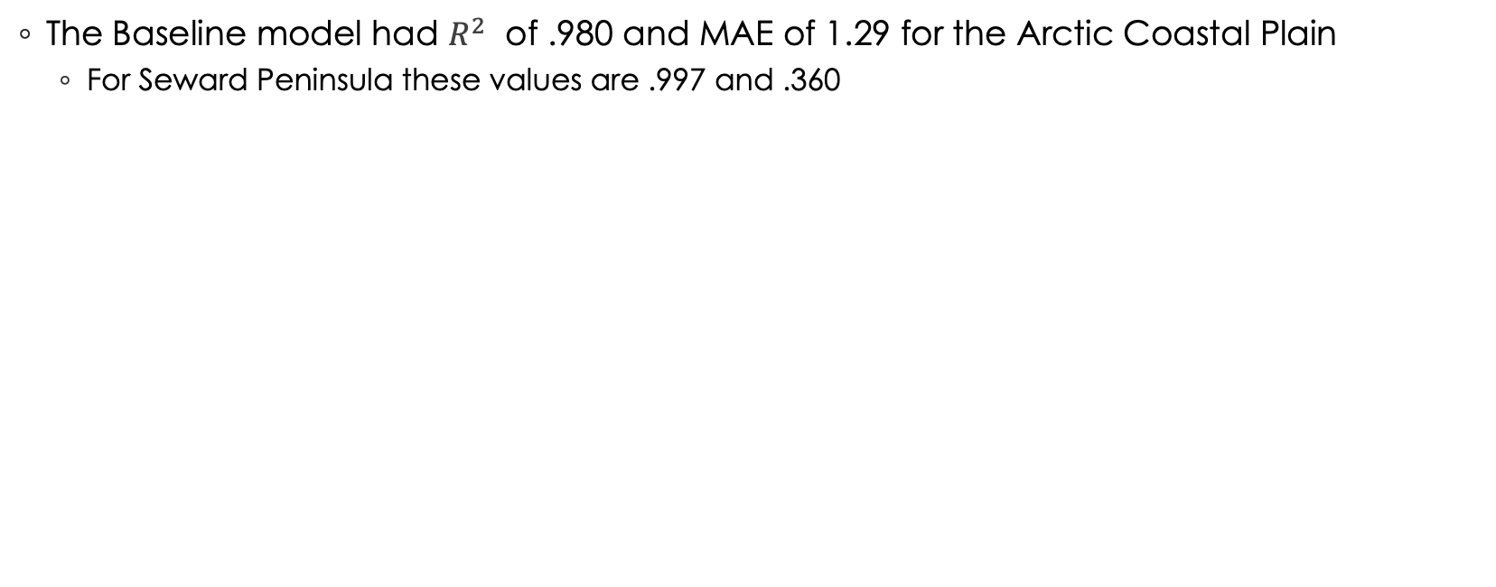
The Baseline Model
The Baseline model had $R^{2}$ of .980 and MAE of 1.29 for the Arctic Coastal Plain
For Seward Peninsula these values are .997 and .360
Name | Area | Summer | Late Summer | Early Winter | Total Winter | Next Summer | TDD | FDD | Next Summer's TDD | Latitude | Longitude | Elevation | Slope | Aspect
baseline | ACP | 9.21 | 13.34 | 9.91 | 9.58 | 12.75 | 9.71 | 11.70 | 8.13 | 8.40 | 7.24 | 0.00 | 0.02 | 0.00
 | SP | 9.09 | 14.61 | 11.75 | 11.20 | 13.12 | 10.50 | 11.49 | 7.98 | 5.14 | 5.11 | 0.00 | 0.02 | 0.00
Climate Priming Predictions
Random Forest Predictions
Pixel Difference
Notes:
Hyper parameters:
50 estimators
Maximum tree depth of 100
All Features considered for decisions
50,000 maximum leaf node
Minimum samples needed to split a node is 8
Minimum sample to be a leaf is 5
75 % of available data used as training data
Here you can see it applied to the seward peninsula for 2004
Left original model
middle Random forest
right difference

Slide 36
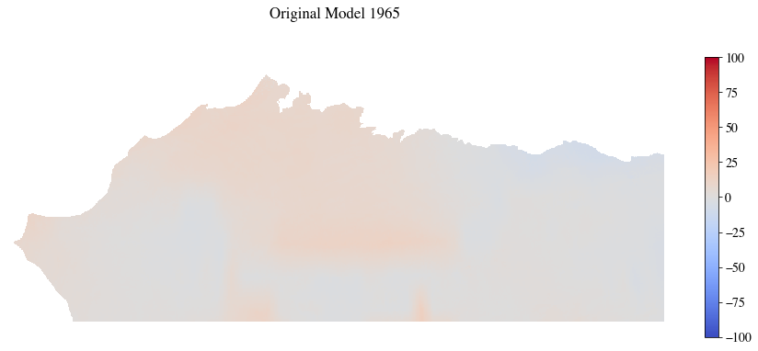
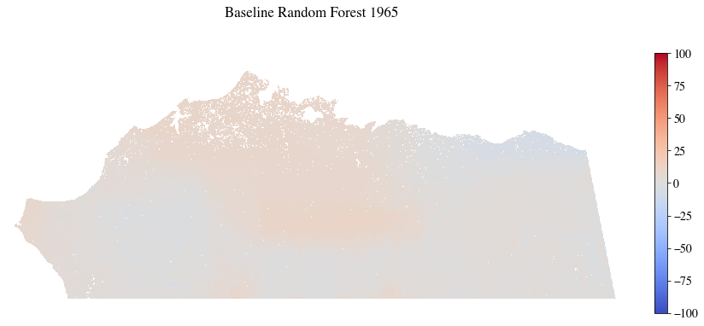
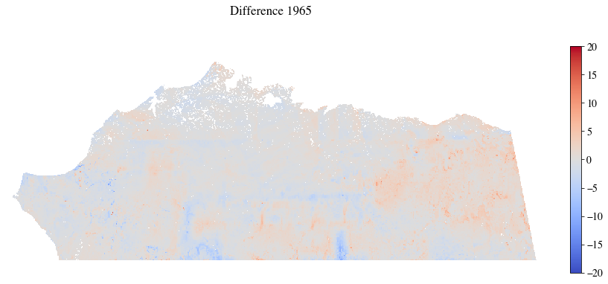
DDDDffff
Baseline Random Forest Predictions
Climate Priming Predictions
Pixel Difference
1965

Slide 37
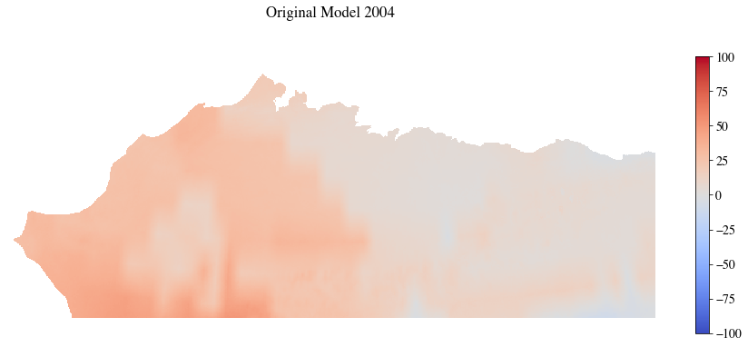
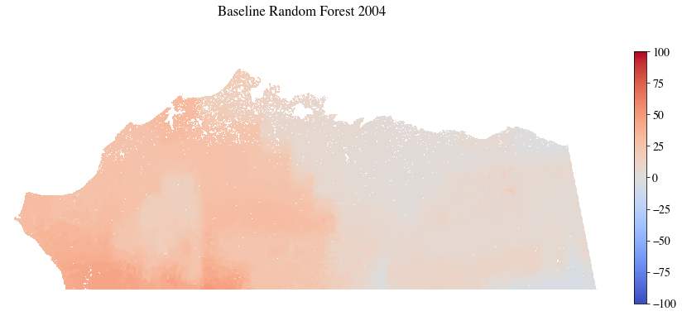
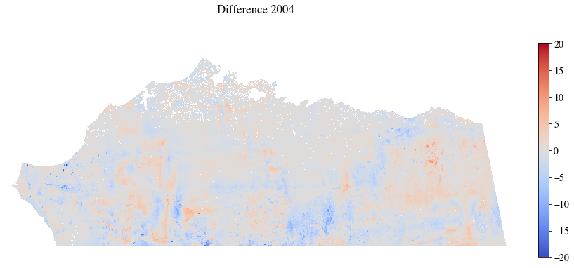
Baseline Random Forest Predictions
Climate Priming Predictions
Pixel Difference
2004

Slide 38
Sensitivity Analysis
Feature Based
Hyperparameter Based
Notes:
2 types

Slide 39
Feature Sensitivity Analysis
ADD
Original Results
Random Data
REMOVE
Latitude & Longitude
Elevation, Slope, & Aspect
Partial Season Precipitations
Features with lowest Importance
Features with highest Importance
Notes:
Look at changing data used in training to examine random forest model resilience
These are the tests I performed
Adding original model results( the labels used for traning), and a randomly generated data to traning features
Removing various features to see how accuracy was effected, Including the location, lower imporatce features and higher imporacnce features

Slide 40
Feature Sensitivity Analysis Results
Original Results will be selected as main driver of decision process
Random Data is ignored
Features with Vary Low Importance may be removed
Removing Features other not advisable if all have similar feature importance scores
Removing Latitude and Longitude does not effect these results, but models are still limited to training region
Notes:
The key take aways from this analysis were
The original labels became primary decision feature. Which was expeted, and shows that RF models can find important things
The random Data was Ignored, which show that RFs likely show the models ignore are unimporatant
Can safly remove features with very low importance from the training features
Can’t remove other features here, because they are all labeled with feature impotance
the more you remove the worse accuracy becomes
Was able remove Lat and long, but it did not create a location agnostic model

Slide 41
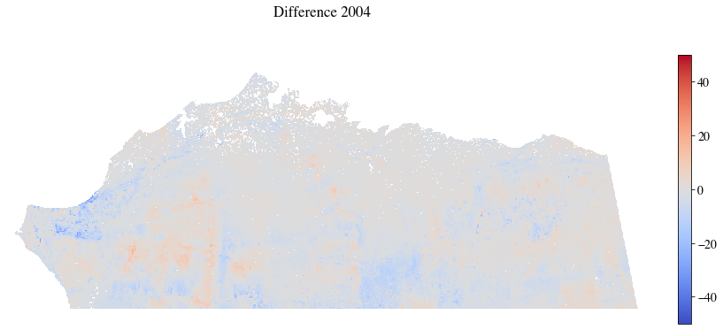
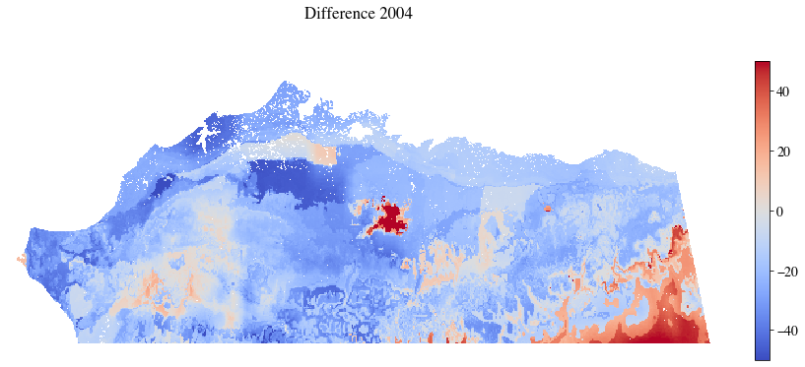
Remove Latitude & Longitude
ACP trained model with ACP data error for 2004
SP trained model with ACP data error for 2004
Notes:
Example of removing latitude and Longitude
Top is the ACP trained model tested with ACP data
Bottom is the SP Trained model rested with ACP data

Slide 42
Feature based
Add
The original labels (results of original model) to features used in training
RF model should find this
Add
Random Data to features used in training
RF should Ignore this
Remove
Latitude and Longitude
Can RF predict as well with out these, and how does feature importance change
Remove
Elevation and Slope Features
These have near 0 Feature importance so removing them should not effect model performance

Slide 43
Feature based
Remove
Partial Season Precipitation
Is this possibly being considered twice?
Remove
Lowest importance features
Can RF adapt and perform well with out these
Remove
Highest importance features
Can RF adapt and perform well with out these
Remove
Highest importance features and Latitude/Longitude
Can RF adapt and perform well with out these

Slide 44
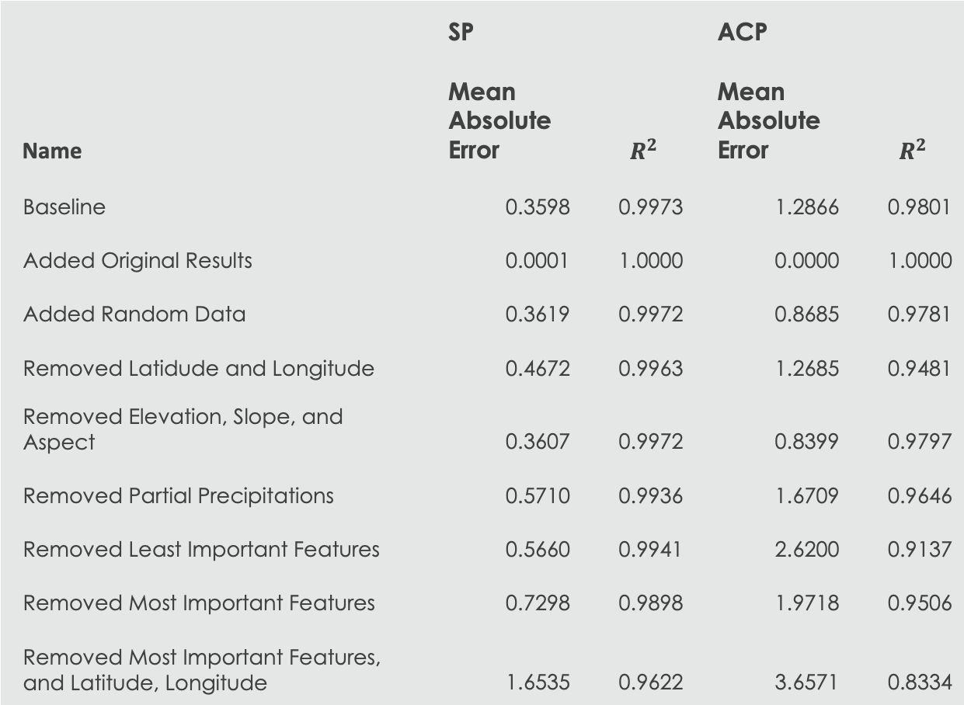
Feature Based Accuracy Summary
Name | SP |  | ACP
 | Mean Absolute Error | $$R^{2}$$ | Mean Absolute Error | $$R^{2}$$
Baseline | 0.3598 | 0.9973 | 1.2866 | 0.9801
Added Original Results | 0.0001 | 1.0000 | 0.0000 | 1.0000
Added Random Data | 0.3619 | 0.9972 | 0.8685 | 0.9781
Removed Latidude and Longitude | 0.4672 | 0.9963 | 1.2685 | 0.9481
Removed Elevation, Slope, and Aspect | 0.3607 | 0.9972 | 0.8399 | 0.9797
Removed Partial Precipitations | 0.5710 | 0.9936 | 1.6709 | 0.9646
Removed Least Important Features | 0.5660 | 0.9941 | 2.6200 | 0.9137
Removed Most Important Features | 0.7298 | 0.9898 | 1.9718 | 0.9506
Removed Most Important Features, and Latitude, Longitude | 1.6535 | 0.9622 | 3.6571 | 0.8334

Slide 45
Feature Importance ACP
 | Precipitation |  |  |  |  | Temperature |  |  | Location |  | Elevation | Slope |  | Other
name | Summer | Late Summer | Early Winter | Total Winter | Next Summer | TDD | FDD | Next Summer's TDD | Latitude | Longitude | Elevation | Slope | Aspect | Labels | Random
Baseline | 9.21 | 13.34 | 9.91 | 9.58 | 12.75 | 9.71 | 11.70 | 8.13 | 8.40 | 7.24 | 0.00 | 0.02 | 0.00
Added Original Results | 0.00 | 0.00 | 0.00 | 0.00 | 0.00 | 0.00 | 0.00 | 0.00 | 0.00 | 0.00 | 0.00 | 0.00 | 0.00 | 100.00
Added Random | 9.19 | 13.19 | 9.92 | 9.69 | 12.80 | 9.46 | 11.72 | 8.33 | 8.35 | 7.32 | 0.00 | 0.02 | 0.00 |  | 0.00
Remove Latitude/ Longitude | 14.16 | 12.61 | 14.19 | 10.89 | 15.34 | 10.23 | 12.11 | 9.42 |  |  | 0.01 | 1.04 | 0.00
Removed Elevation, Slope and Aspect | 12.59 | 9.95 | 11.73 | 9.73 | 13.44 | 8.42 | 9.56 | 8.08 | 7.20 | 9.30
Removed Partial Precipitation | 16.77 |  |  | 11.87 | 16.45 | 10.76 | 12.25 | 12.36 | 7.85 | 11.60 | 0.00 | 0.07 | 0.00
Removed Least Important | 18.23 | 16.23 | 16.00 | 14.62 | 20.88 |  | 14.05
Removed Most Important |  | 19.15 |  | 15.07 |  | 14.14 | 14.07 | 14.60 | 9.51 | 13.32 | 0.01 | 0.14 | 0.00
And Latitude/ Longitude |  | 21.38 |  | 18.36 |  | 19.45 | 18.21 | 20.13 |  |  | 0.17 | 2.29 | 0.02

Slide 46
Feature Importance Seward Peninsula
 | Precipitation |  |  |  |  | Temperature |  |  | Location |  | Elevation | Slope |  | Other
name | Summer | Late Summer | Early Winter | Total Winter | Next Summer | TDD | FDD | Next Summer's TDD | Latitude | Longitude | Elevation | Slope | Aspect | Labels | Random
Baseline | 9.09 | 14.61 | 11.75 | 11.20 | 13.12 | 10.50 | 11.49 | 7.98 | 5.14 | 5.11 | 0.00 | 0.02 | 0.00
Added Original Results | 0.00 | 0.00 | 0.00 | 0.00 | 0.00 | 0.00 | 0.00 | 0.00 | 0.00 | 0.00 | 0.00 | 0.00 | 0.00 | 100.00
Added Random | 9.24 | 14.70 | 11.80 | 11.04 | 13.29 | 10.41 | 11.42 | 7.97 | 5.20 | 4.89 | 0.00 | 0.02 | 0.00 |  | 0.00
Remove Latitude/ Longitude | 11.62 | 17.20 | 12.52 | 12.56 | 14.05 | 11.11 | 12.06 | 8.72 |  |  | 0.01 | 0.15 | 0.01
Removed Elevation, Slope and Aspect | 9.27 | 14.70 | 11.60 | 11.24 | 13.27 | 10.56 | 11.24 | 7.83 | 5.20 | 5.10
Removed Partial Precipitation | 14.86 |  |  | 15.00 | 15.86 | 13.77 | 15.27 | 11.15 | 6.87 | 7.01 | 0.02 | 0.19 | 0.01
Removed Least Important | 15.77 | 21.46 | 15.67 | 15.77 | 18.43 |  | 12.90
Removed Most Important |  | 19.45 |  | 15.81 |  | 15.66 | 17.03 | 13.63 | 9.11 | 8.95 | 0.04 | 0.31 | 0.02
And Latitude/ Longitude |  | 22.98 |  | 19.79 |  | 19.75 | 18.68 | 16.77 |  |  | 0.26 | 1.66 | 0.12

Slide 47
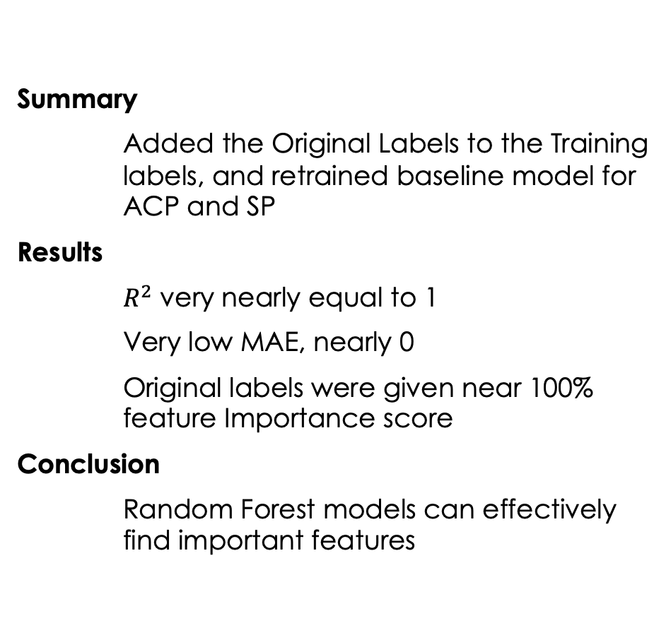
Original Results In Training Features
Summary
Added the Original Labels to the Training labels, and retrained baseline model for ACP and SP
Results
$R^{2}$ very nearly equal to 1
Very low MAE, nearly 0
Original labels were given near 100% feature Importance score
Conclusion
Random Forest models can effectively find important features
Notes:
R2 :
SP: 0.999 999 99 7629665
ACP: 0.999 999 999 89828
MAE:
ACP: 6.06E-05
SP: 0.00010299

Slide 48
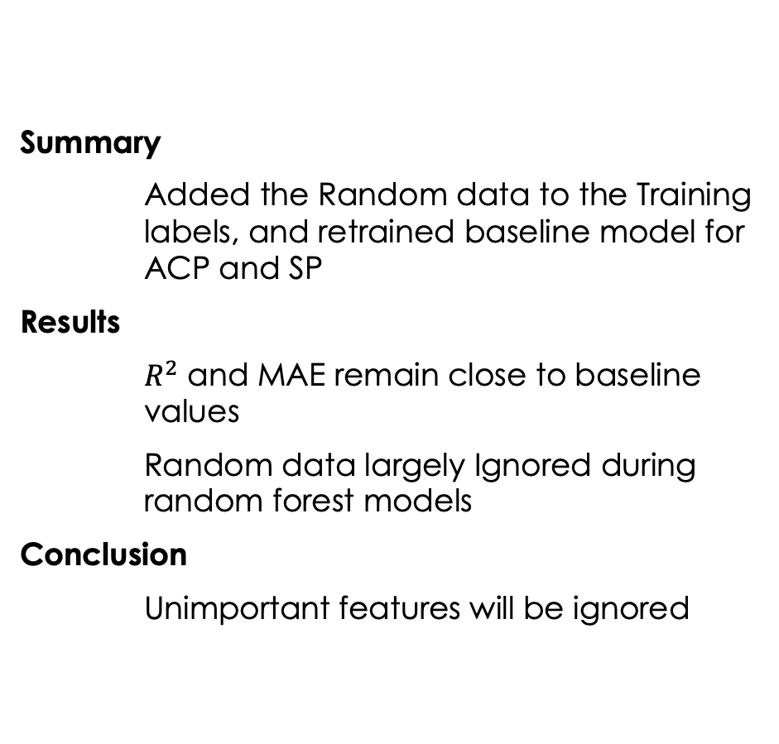
Random Data In Training Features
Summary
Added the Random data to the Training labels, and retrained baseline model for ACP and SP
Results
$R^{2}$ and MAE remain close to baseline values
Random data largely Ignored during random forest models
Conclusion
Unimportant features will be ignored

Slide 49
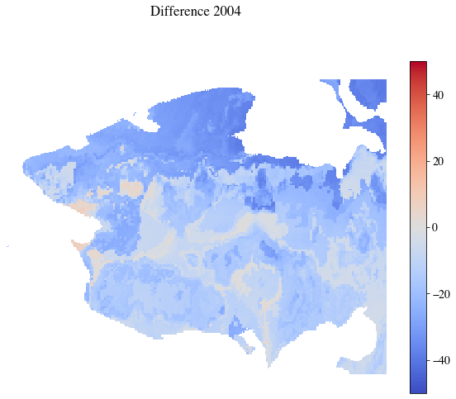
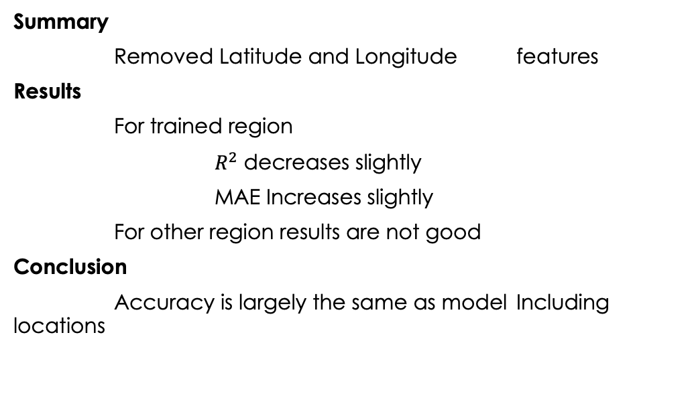
Removed Latitude and Longitude
Summary
Removed Latitude and Longitude features
Results
For trained region
$R^{2}$ decreases slightly
MAE Increases slightly
For other region results are not good
Conclusion
Accuracy is largely the same as model Including locations

Slide 50
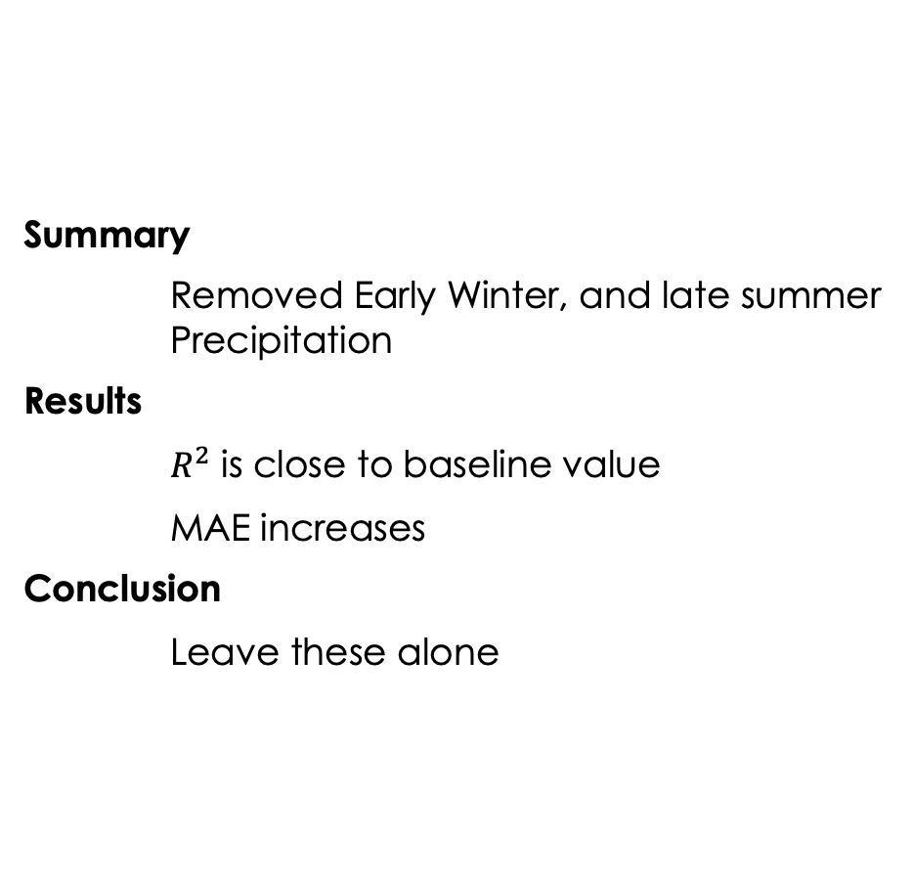
Removed Partial Season Precipitation
Summary
Removed Early Winter, and late summer Precipitation
Results
$R^{2}$ is close to baseline value
MAE increases
Conclusion
Leave these alone
Notes:
Summer precip, and sp+1 seems to have picked the slcak

Slide 51
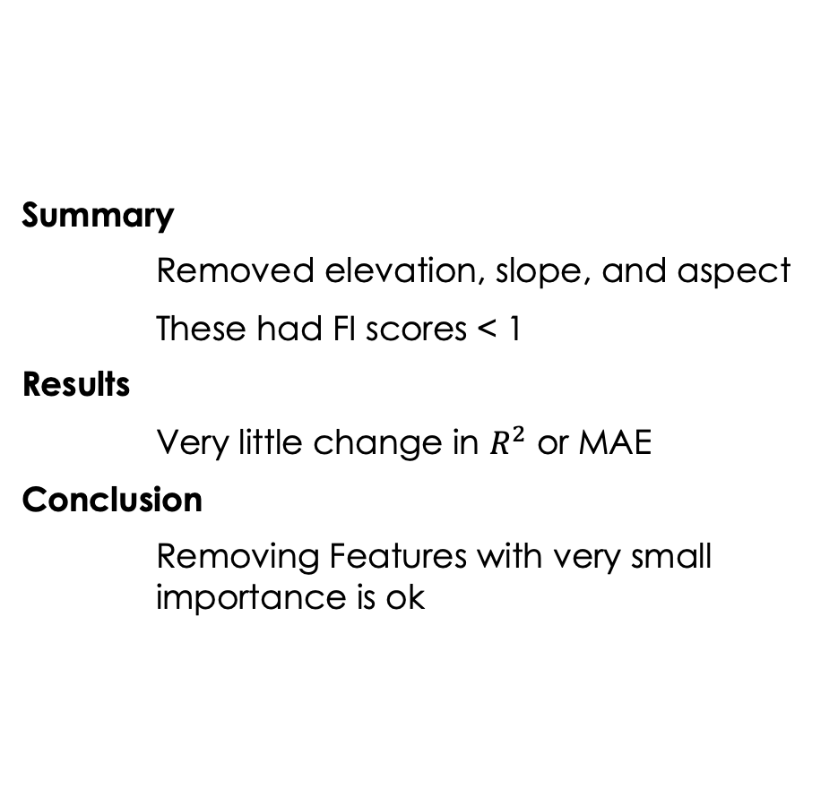
Removed elevation, slope, and aspect
Summary
Removed elevation, slope, and aspect
These had FI scores < 1
Results
Very little change in $R^{2}$ or MAE
Conclusion
Removing Features with very small importance is ok

Slide 52
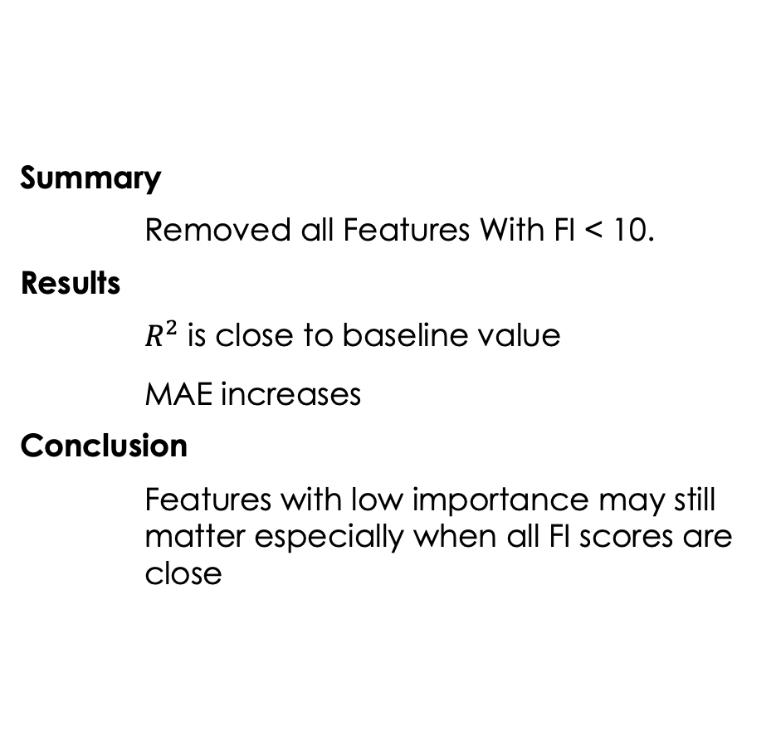
Removed Lowest Importance Features
Summary
Removed all Features With FI < 10.
Results
$R^{2} \text{is} \text{close} \text{to} \text{baseline} \text{value}$
$\text{MAE} \text{increases}$
Conclusion
Features with low importance may still matter especially when all FI scores are close

Slide 53
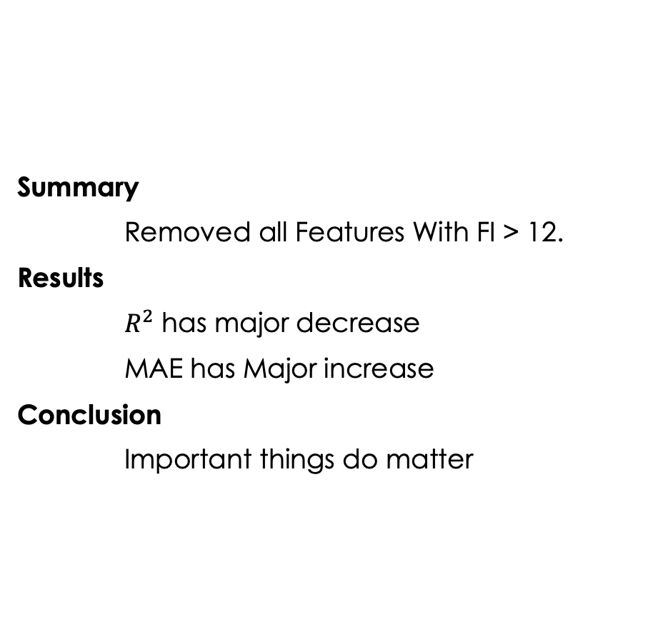
Removed Highest importance features
Summary
Removed all Features With FI > 12.
Results
$R^{2}$ has major decrease
MAE has Major increase
Conclusion
Important things do matter

Slide 54

Removed Highest importance features and latitude/ Longitude
Summary
Removed all Features With FI > 12.
Results
$R^{2}$ has major decrease
MAE has Major increase
More so than previous scenario
Conclusion
Important things do matter, but so do less important things

Slide 55
Hyperparameter Sensitivity Analysis
Vary
Estimators
Max Tree Depth
Max Features for Decisions
Max Leaf Nodes
Min Samples to Split
Min Samples per Leaf
Percent Training Data
Notes:
Wanted to look at optimal hyperparametes
Make incremental changes to hyperparameters to find how they effect model performance

Slide 56
Hyperparameter Based
Vary Estimators
More estimators should give better results
Vary Max Depth
Increasing max depth should mater until it would produce more leaf nodes than max leaf nodes
Vary Max Features for decisions
How is performance Effected
Vary Max Leaf Nodes
increasing max lead nodes should have similar effect to increasing max depth, but wont matter if the max depth is too small
Vary Min Samples to split
How does this effect performance
Vary Min samples per leaf
How does this effect performance
Vary Percent data used in training
How little data is needed for good predictions
Notes:
Make incidental changes to hyper parameters to find how they effect model performance

Slide 57
Results
Baseline model
Feature sensitivity analysis
Hyperparameter sensitivity analysis

Slide 58
Feature based
Add
The original labels to features used in training
Add
Random Data to features used in training
Remove
Latitude and Longitude
Remove
Elevation and Slope Features
Remove
Partial Season Precipitation
Remove
Lowest importance features
Remove
Highest importance features
Remove
Highest importance features and Latitude/Longitude

Slide 59
Hyper Parameter Based
Results

Slide 60

Vary Number of Estimators
Baseline value of 50 appears to work well here
Once Number of estimators > ~20 accuracy increase is negligible and may decrease.
Notes:
ESTIMATORS is genneraly considered an importuned HP
Here you can see that increasing the # increases accuracy, but that increase stops being significant after about 20

Slide 61

Maximum Tree Depth
Tree depth increases stop increasing accuracy between 20 and 30
This is somewhat Limited by max leaf nodes selection.
Notes:
Increasing max depth increase accuracy untll r2 gets close to one.

Slide 62

Maximum Decision Features
Any value greater than 4 seems good, but for these models’ accuracy decreases slightly after 10 or 11
Notes:
Other HP generally considered important
Increasing it increases accuracy until it doesnt

Slide 63
Hyperparameter Sensitivity Analysis Results
Should likely choose one of the following to control tree size
Maximum Tree Depth
Maximum Leaf Nodes
All tested percentages of data used for training preformed similarly
Changing minimum samples for splitting a node and minimum samples for leaf had little effect
Notes:
Choose one to limit the tree size
max depth
max leaf nodes ( I would choose this)
The Pecntage data used matters, but only slightly for this case.
Was able to show that training with twice as much data takes twich as much time, and 3x data = 3x time, but the accuracy increase is only slight
The other Hyper parameter chages made little difference

Slide 66
Conclusions

Slide 67
Discussion
Double check data for label correctness.
Find a good starting point.
Timing is hard to measure on disturbed systems.
Notes:
Data was wrong oops
Had to redo abunch of stuff at the last minute
Think through were to start more than I did, because it ended up being more confusing for a while
Timign is hard to meauser on distributed systems
I tried normailizing it and that didn’t even work

Slide 68
Conclusions
Random forest Modeling works well for this purpose
Models work best when trained for specific regions
Feature importance is not a good indicator of inputs to remove if all features score similarly.
Removing features has a cumulative effect
Most important hyperparameters are number of estimators, number or decision features, and those that control tree size
Notes:
The model chosen as the baseline model worked well here,

Slide 69
Acknowledgments
The Alaska Climate Adaptation Science Center
The Department of Energy Office of Biological and Environmental Research Next Generation Ecosystem Experiment (NGEE-Arctic).

Slide 70
Questions

Slide 72
References
Breiman L. “Random Forests”. Machine Learning, Kluwer Academic Publishers 2001.
McGovern A., elmore K.L., Gangne D.J., Haupt S.E. , Karstens K.A., lagerquist R., Smith T., and. Williams J.k. “USING ARTIFICIAL INTELLIGENCE TO IMPROVE REAL-TIME DECISION-MAKING FOR HIGH-IMPACT WEATHER”. AMERICAN METEOROLOGICAL SOCIETY 2018
Hastie, T., Tibshirani, R, and Friedman J, “The Elements of Statistical Learning” Second Edition. Springer 2017
scikit-learn-developers, "3.2.4.3.2. sklearn.ensemble.RandomForestRegressor - scikit-learn 0.21.3 documentation," [Online]. Available: https://scikit-learn.org/0.21/modules/generated/sklearn.ensemble.RandomForestRegressor.html#sklearn.ensemble.RandomForestRegressor. [Accessed 05 02 2020].
W. Pollard, "Chapter 15 - Periglacial Processes in Glacial Environments," in Past Glacial Environments, Second Edition., J. Menzies and J. J. van der Meer, Eds., Elsevier, 2018, pp. 537-564.
Brown,J., O.J.Ferrians,Jr., J.A. Heginboom, and E.S. Melnikov. 1998, revised February 2001. Circum-arc map of permafrost and ground ice conditions. Boulder, CO: National Snow and Ice Data Center. Digital media.
Jorgenson,T.,K.Yoshikawa, M.Kanevskyi,Y.Shur ,V. Romanovsky, S. Marchenko, G. Grosse, J. Brown, B. Jones. 2008. Permafrost Characteristics of Alaska. Institute of Northern Engineering, University of Alaska Fairbanks, NICOP.
Herman, G.R., Schumacher, R.S. 2018. Money Doesn't Grow on trees but Forecasts do: Forecasting Extreme Precipitation with Random Forests. American Meteorological Society
Hugelius,G.,C. Tarnocai, G.Broll,J.G.Canadell, P.Kuhry, D.K. Swanson. 2013. The Northern Circumpolar Soil Carbon Database: spatially distributed datasets of soil coverage and soil carbon storage in the northern permafrost regions. Earth System Science Data 5: 3–13
Scenarios Network for Alaska and Arctic Planning, University of Alaska. 2019 Historical Monthly Precipitation - 1 km CRU TS - Datasets - SNAP Data Portal . Retrieved 2019-11-04 from http://ckan.snap.uaf.edu/dataset/historical- monthly-precipitation-1-km-cru-ts
Scenarios Network for Alaska and Arctic Planning, University of Alaska. 2019 Historical Monthly Temperature - 1 km CRU TS - Datasets - SNAP Data Portal. Retrieved 2019-11-04 from http://ckan.snap.uaf.edu/dataset/historical- monthly-temperature-1-km-cru-ts
Scenarios Network for Alaska and Arctic Planning, University of Alaska. 2019. Thermokarst Formation - Datasets - SNAP Data Portal. Retrieved 2019-06-21 from http://ckan.snap.uaf.edu/dataset/thermokarst-formation.

Slide 73

Maximum Leaf Nodes
Model Accuracy increase asymptoticly as maximum leaf nodes increases, and baseline value (50,000) seems fine

Slide 74

Min Samples for Leaf
Any small value seems fine, as all measured accuracies are in small range (.005)

Slide 75
Minimum samples for splitting node
All tested values produces similar results

Slide 76

Percent data used for training
More training data gives better accuracy but at increased training time cost.
Training times for SP
25%: 03:00.0
50%: 06:22.3
75%: 09:43.4

